Slide 1
Project python
Visualization (Boxplot)

Slide 2
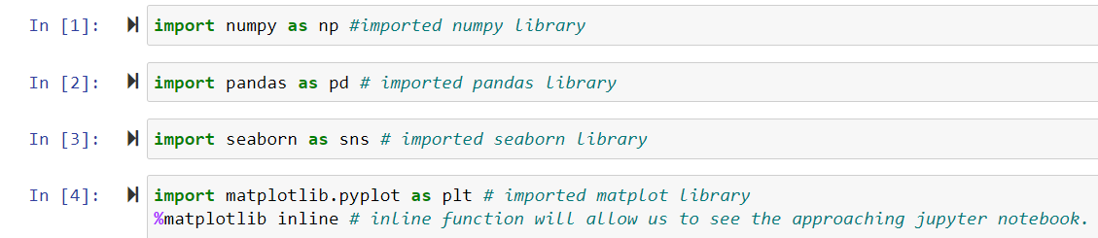
Step1: importing python libraries in jupyter environment

Slide 3
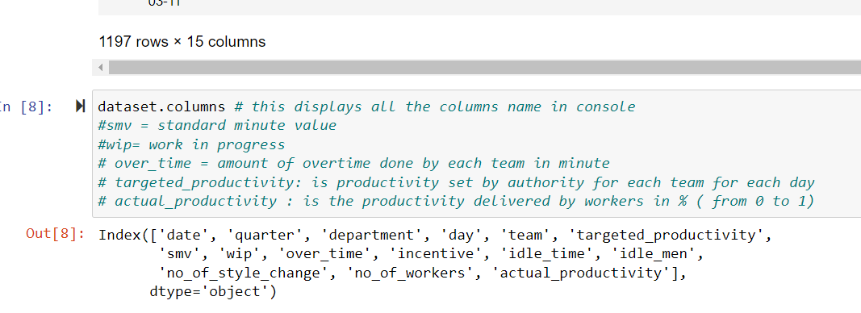
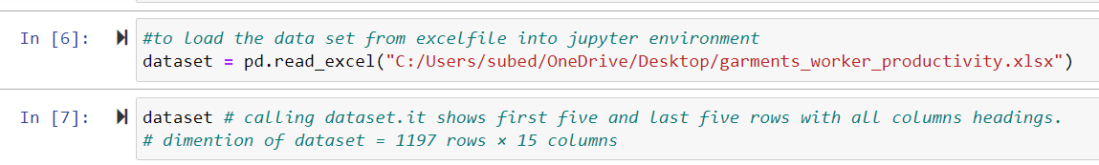
Step: 2: loading excel data file from my computer into jupyter environment. Showing columns.

Slide 4
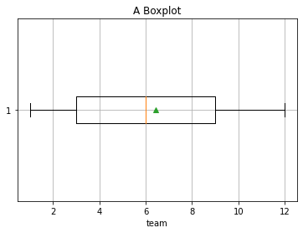
Introduction Box-plot
A box plot is a graphical display of the distribution of data.
It helps to interpret data based on 5 key numbers.
They are minimum, first quartile, median, third quartile and maximum with outliers.
IQR: distance between first and third quartile.
Whiskers: lines beyond the IQR ( = 1.5* IQR on either side)
Outliners: numbers beyond the minimum and maximum points.
what inference can we get from box plot/ Applications
About the median value of data
About the distribution of data (either uniform or skewed)/Symmetry of data
About the degree of dispersion of data
outliners values
data skewness

Slide 5
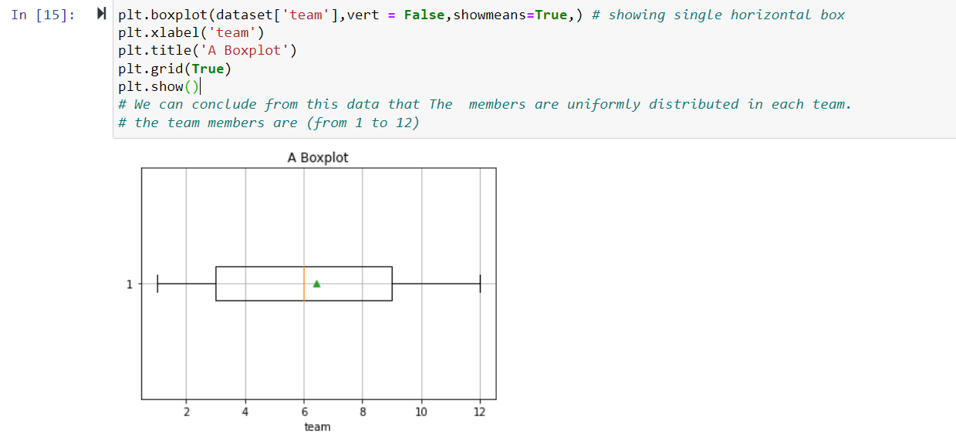
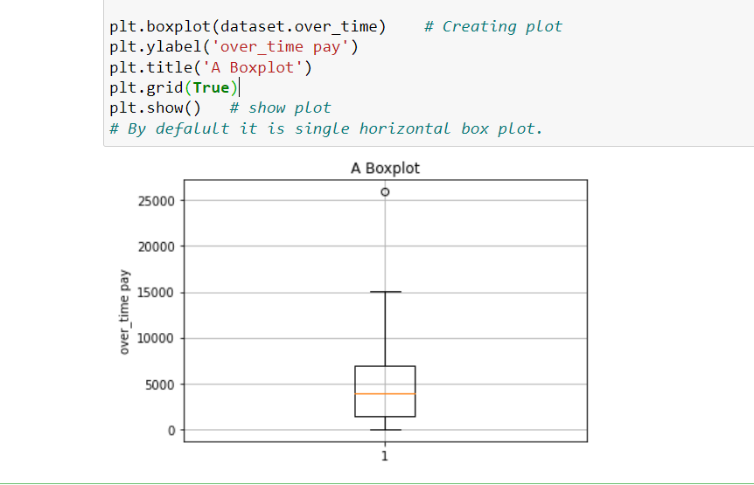
Step :3 Creating boxplot

Slide 6
Step:4 Visualization
1: Comparison of targeted and actual productivity with department.
what we got is the actual productivity is more than the expected one.
that means the data is showing higher efficiency in result.
The finishing department has highest actual productivity

Slide 7
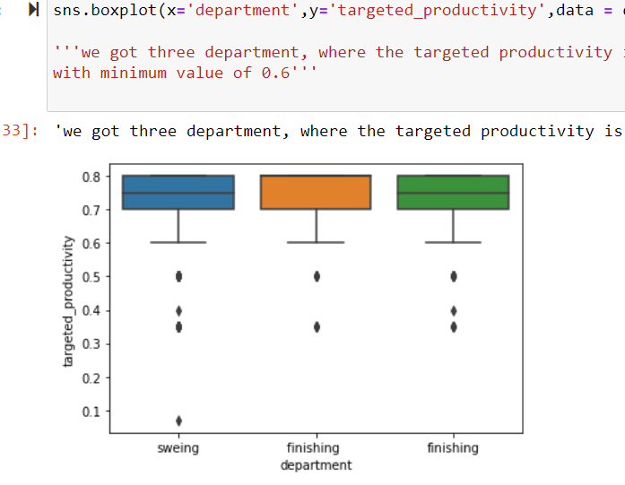
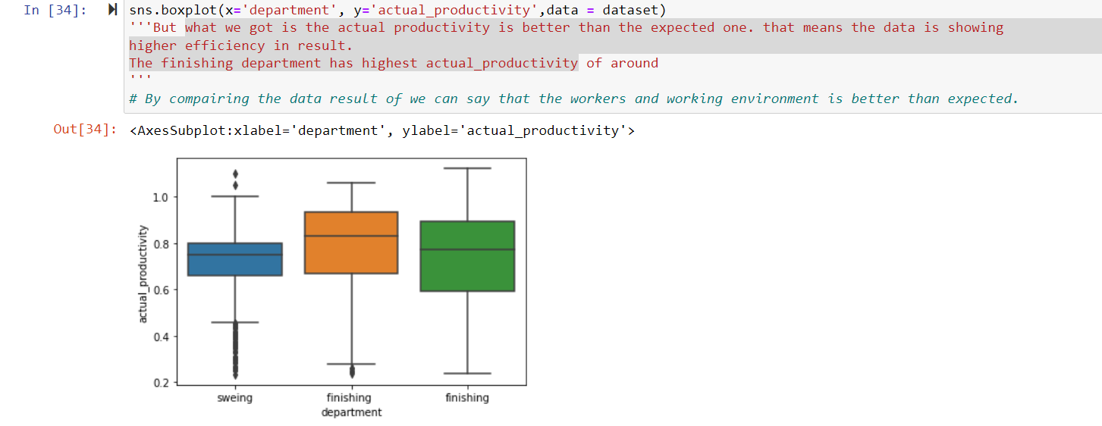
Productivity result with department

Slide 8
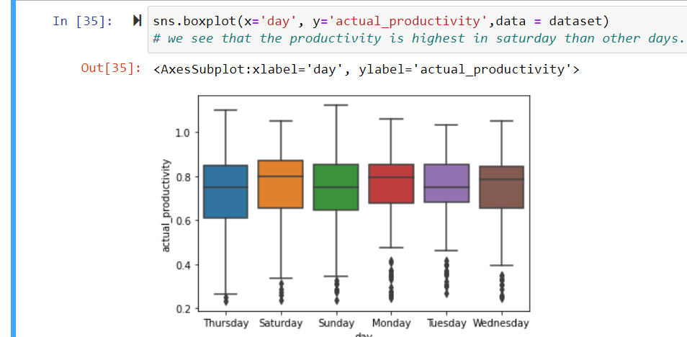
2: day-wise actual productivity we see that the productivity is highest on Saturday than other days.

Slide 9
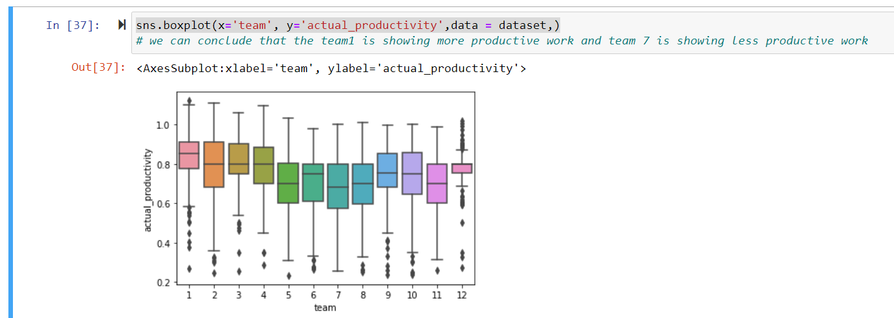
3: most productive teams we can conclude that the team 5,6,7,8 are less productive than other teams.

Slide 10
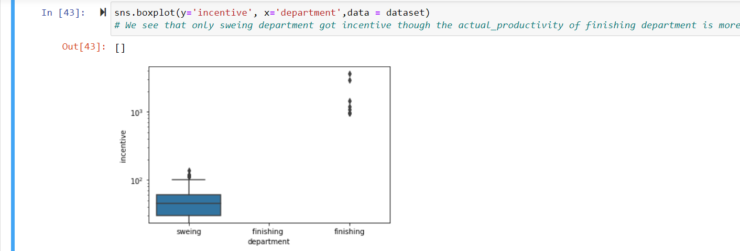
4: incentive to department Only sewing department got incentive.

Slide 11
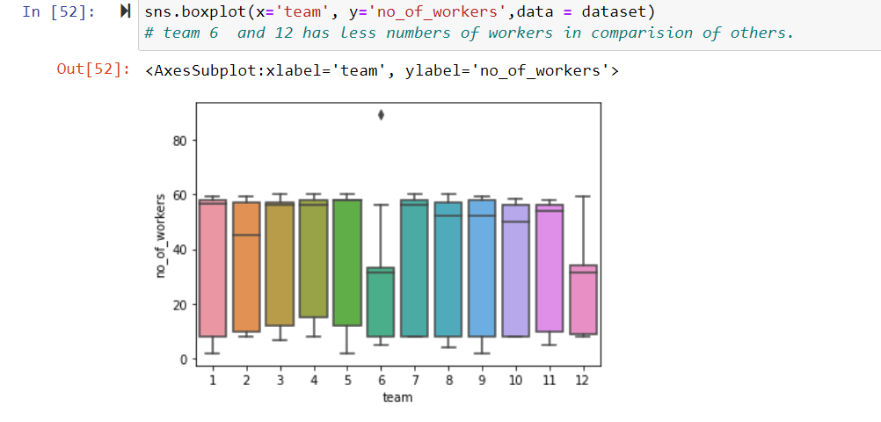
5:No of workers in each team Team 6 and 12 have lesser numers of workers than others.

Slide 12
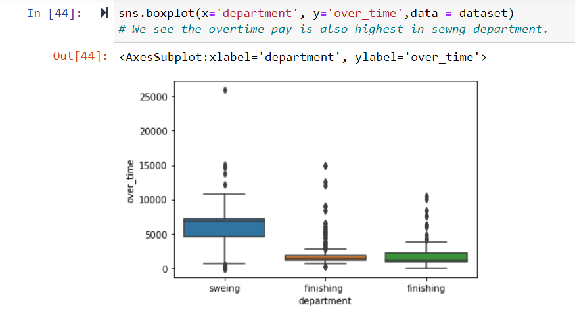
6: Department who are paid more overtime. We got the overtime pay is highest in sewing department.

Slide 13
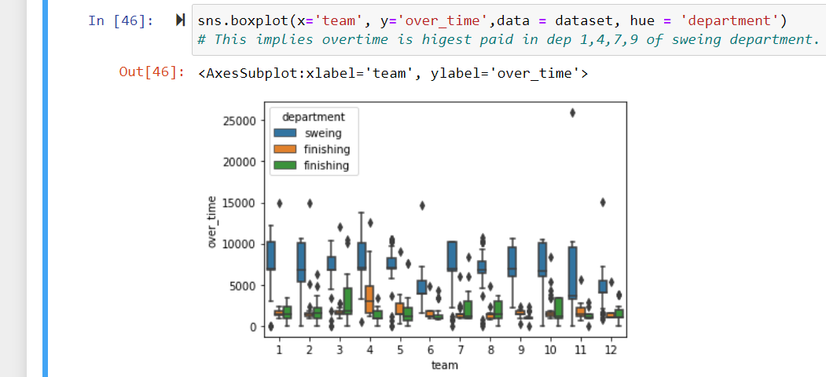
7: Team which is paid highest overtime. This implies overtime is highest paid to team1,4,7,9.

Slide 14
Thank you!

